Slide 1
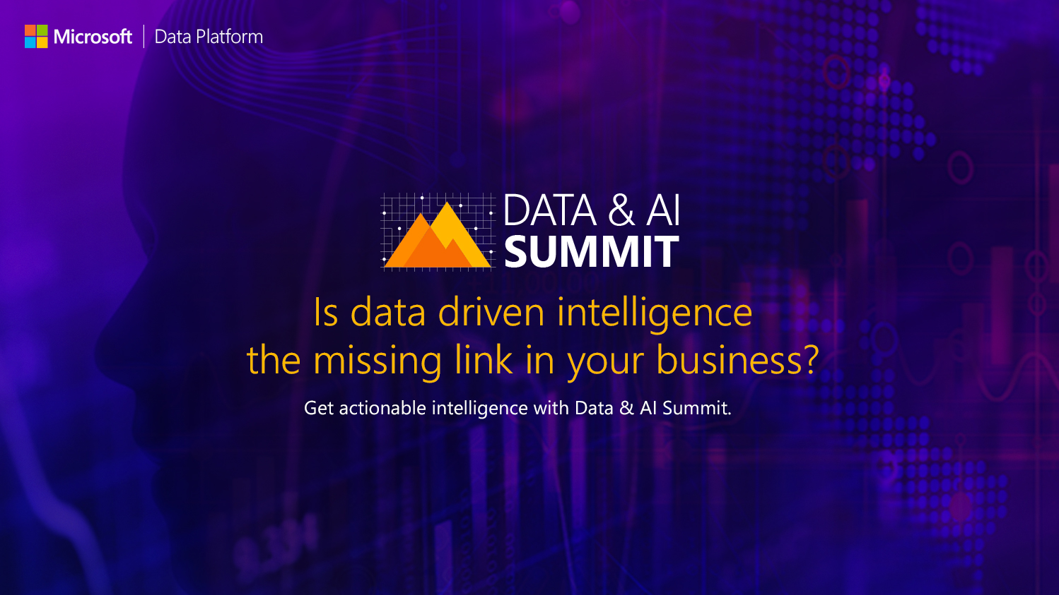

Slide 2
Platform of your choice: Freedom to choose Windows, Linux or Docker Containers for SQL Server
Sanjay Nagamangalam
Principal Program Manager
Database Systems Group
sanagama@microsoft.com
Twitter: @sanagama2
Notes:
Today we’re going to talk about SQL Server 2017 and support for Linux
Show of hands – how many people use Linux?
Use other databases on Linux? MySQL, PgSql?

Slide 3
Businesses are embracing choice
Heterogenous environments
Multiple data types
Different development languages
On-premises, cloud, and hybrid environments
101001010010
{ }
T-SQL
Java
C/C++
C#/VB.NET
PHP
Node.js
Python
Ruby
Notes:
The business landscape is becoming increasingly diverse
Development &deployment environments include Windows, Linux, macOS, and Docker
Data is no longer relational, companies are accessing diverse data, including video, streaming, documents, relational.
This data is both external data and data internal to their org
Languages and frameworks are also expanding with the poularity of Node.js, Python, Ruby and others
Companies deploy on-premises, in the cloud, or both, with a hybrid solution
Many enterprises use private cloud stacks such as Pivotal, Cloud Foundry, etc. that are all based on Linux.
We were starting to get locked out of these places because of this trend – and we decided to fix it.
By offering SQL Server on Linux, so customers have the choice of using SQL wherever they want.
To be honest, this isn’t the first time we’ve considered this – but the conditions were never quite right in the past.

Slide 4
Microsoft is delivering on choice
NEW
SQL Server on Linux
HDInsight on Linux
R Server on Linux
Linux in Azure
SQL Server drivers and connectivity
Visual Studio Code extension for SQL Server
Python, Ruby, …
20,000 applications for the SQL Server on Linux private preview program, including more than 55% of Fortune 500 companies.
NEW
Notes:
Microsoft has delivered a number of products enabling choice for customers, including:
HD Insight on Linux - a managed Apache Hadoop, Spark, R, HBase, and Storm cloud service made easy
R Server on Linux - Use R—the powerful, statistical programming language—in an enterprise-class, big data analytics platform. Microsoft R Server is your flexible choice for analyzing data at scale, building intelligent apps, and discovering valuable insights across your business (https://www.microsoft.com/en-us/cloud-platform/r-server)
Linux in Azure – run Linux-based virtual machines in Microsoft Azure (IaaS)
Customers can take advantage of Microsoft–created database connectivity drivers and open-source drivers that enable developers to build any application using the platforms and tools of their choice, including Python, Ruby, and Node.js

Slide 5
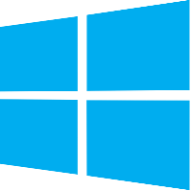


SQL Server 2017
Run anywhere and build apps using the language of your choice
Analyze complex relationships with support for graph objects & queries
Advanced Machine Learning with R & Python
Unparalleled performance with adaptive query processing
SQL Server 2017
Industry-leading, most secure data platform with built-in intelligence for all your data
Notes:
Run anywhere and build apps using the language of your choice
Analyze complex relationships with support for graph data
Advanced Machine Learning with R & Python
Unparalleled performance with adaptive query processing
Runs on the platform of your choice: Windows / Linux / Docker

Slide 6
Power of SQL Server on the platform of your choice
FLEXIBILITY
Windows
Linux
Linux distributions including RedHat Enterprise Linux (RHEL), Ubuntu, and SUSE Enterprise Linux (SLES)
Docker: Windows & Linux containers
Windows Server / Windows 10
Package-based installation, yum install, app get, and more
Linux/Windows container

Slide 7
Demo
SQL Server on Linux
Install experience
Connect & query
Restore Backup from Windows
Demo scripts are on Github:
https://github.com/sanagama/sql2017-data360
Notes:
When we initially announced SQL on Linux, the social media went berserk and the Linux community was placing bets that Microsoft will completely screw up the install experience.
They said we’ll have some ugly tarball that you’ll have to unzip, etc.
Our goal was to meet developers where they are and provide a platform-appropriate experience.
Let me show you what we did.

Slide 8
Licensing Same license, new choice
Buying a SQL Server license grants the option to use it on Windows Server or Linux
Same familiar set of editions (Enterprise, Standard, Developer, Express)
LICENSE
Notes:
It’s the same license, you buy the license and run SQL wherver you want.
We’re also retaining the same editions (Enterprise, Standard, Developer) – same as before

Slide 9
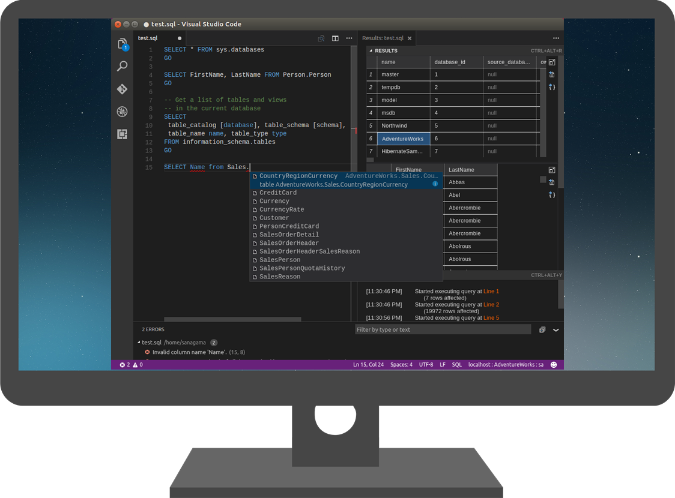
FLEXIBILITY
Tools and programmability
Existing Windows-based SQL Server tools like SSMS, SSDT, Profiler, etc. work when connected to SQL Server on Linux and in Docker
3rd party tools continue to work
All existing drivers and frameworks supported
New Native command line tools: sqlcmd, bcp, sqlpackage
New mssql extension for Visual Studio Code
New cross-platform DB admin GUI tool (planned)

Slide 10
SQL Server in Docker
What
Seamlessly enables database DevOps & CI/CD automation
Include SQL Server 2017 containers as a component of your app for an integrated build, test, and deploy experience.
Benefits
Deliver continuous value to your customers in an agile manner
Greatly reduce variability and increase agility
Enforce a consistent dev/test environment for your team
Dramatically simplify development, testing, and deployment of applications
Easily integrate with your existing CI/CD pipelines
Notes:
Package app + deps + SQL Server into a portable environment
2. Share the same state of an application in your container
3. In addition, you can also automate large-scale testing of containerized apps + SQL Server with high-intensity container deployments with managed container services.
e.g. Kubernetes, Docker Swarm, or other orchestration systems. spin up on demand, execute tests, spin down when finished.
SQL Server runs in all these environments

Slide 11
Demo
SQL Server in Docker
Install experience
Connect & query
Easily Provision Pre-Prod and DEV environments
Demo scripts are on Github:
https://github.com/sanagama/sql2017-data360
Notes:
When we initially announced SQL on Linux, the social media went berserk and the Linux community was placing bets that Microsoft will completely screw up the install experience.
They said we’ll have some ugly tarball that you’ll have to unzip, etc.
Our goal was to meet developers where they are and provide a platform-appropriate experience.
Let me show you what we did.

Slide 12
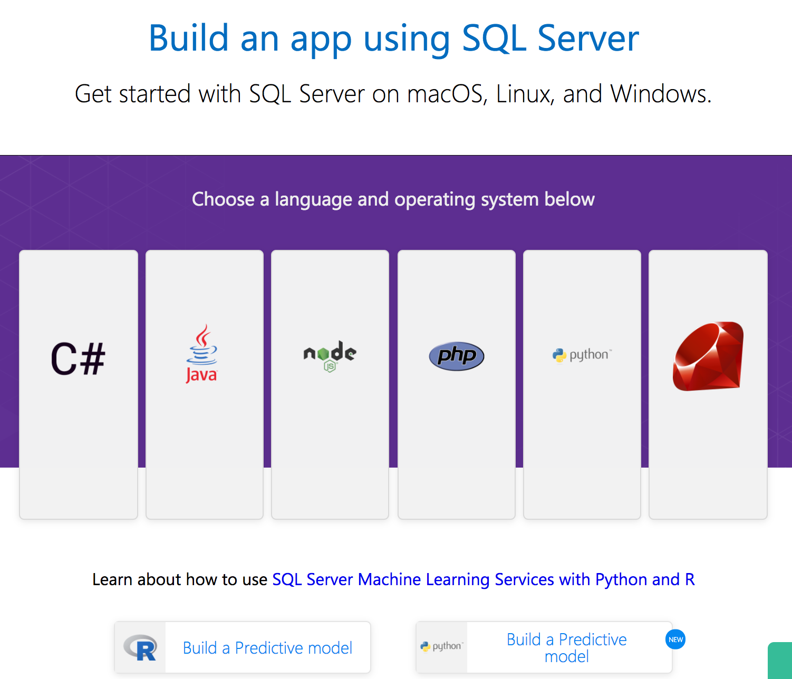
Resources
SQL Server 2017 https://www.microsoft.com/en-us/sql-server/sql-server-2017
Build an app using SQL Server http://aka.ms/sqldev
DevOps using SQL Server http://aka.ms/sqldevops
SQL Server Blog https://blogs.technet.microsoft.com/dataplatforminsider
sanagama@microsoft.com

Slide 13
More Resources
SQL Server Documentation: https://docs.microsoft.com/en-us/sql/linux/
VS Code mssql extension: https://marketplace.visualstudio.com/items?itemName=ms-mssql.mssql
mssql-tools (sqlcmd & bcp): https://docs.microsoft.com/en-us/sql/linux/sql-server-linux-setup-tools
mssql-scripter: https://pypi.python.org/pypi/mssql-scripter
Demo scripts (github): https://github.com/sanagama/sql2017-data360

Slide 14
